Slide 1

STEG-X: An Advanced Steganography Tool
Industrial Training Project (2024–2025)
Kunal Manhas | Roll Number: 12300053 | Btech CSE | batch: (2023-24)DAV University, Jalandhar | Organization: Coder Roots

Slide 2

Introduction to STEG-X
STEG-X is an innovative project focused on developing a robust steganography tool. This 45-day industrial training initiative, conducted at Coder Roots, explores advanced techniques for covert data communication.

Slide 3





Project Objectives
Master LSB Steganography
Develop CLI Tool
Gain a deep understanding of Least Significant Bit techniques.
Build a user-friendly command-line interface in Python.
Implement Core Features
Cybersecurity Experience
Integrate hide, extract, and detection functionalities.
Acquire practical skills in cybersecurity development.

Slide 4



Tools & Technologies
Python
Key Libraries
Command Line Interface (CLI)
The core programming language for development.
stegano, PIL (Pillow), argparse, termcolor for functionality.
Primary platform for user interaction and execution.

Slide 5

Understanding Steganography
What is Steganography?
The art and science of writing hidden messages in such a way that no one, apart from the sender and intended recipient, suspects the existence of the message.
Least Significant Bit (LSB)
A common method where secret data is embedded into the least significant bits of image pixel values, causing minimal visible alteration.
Cybersecurity Relevance
Steganography can be used for covert communication, protecting sensitive data from detection, or as a component in advanced persistent threats.

Slide 6



STEG-X Core Features
Hide Message
Extract Message
Detect Steganography
Embed secret text into an image file, making it imperceptible to the naked eye.
Retrieve hidden text from a steganographic image, revealing the original secret.
Analyze an image for the presence of hidden data, identifying potential covert communications.

Slide 7

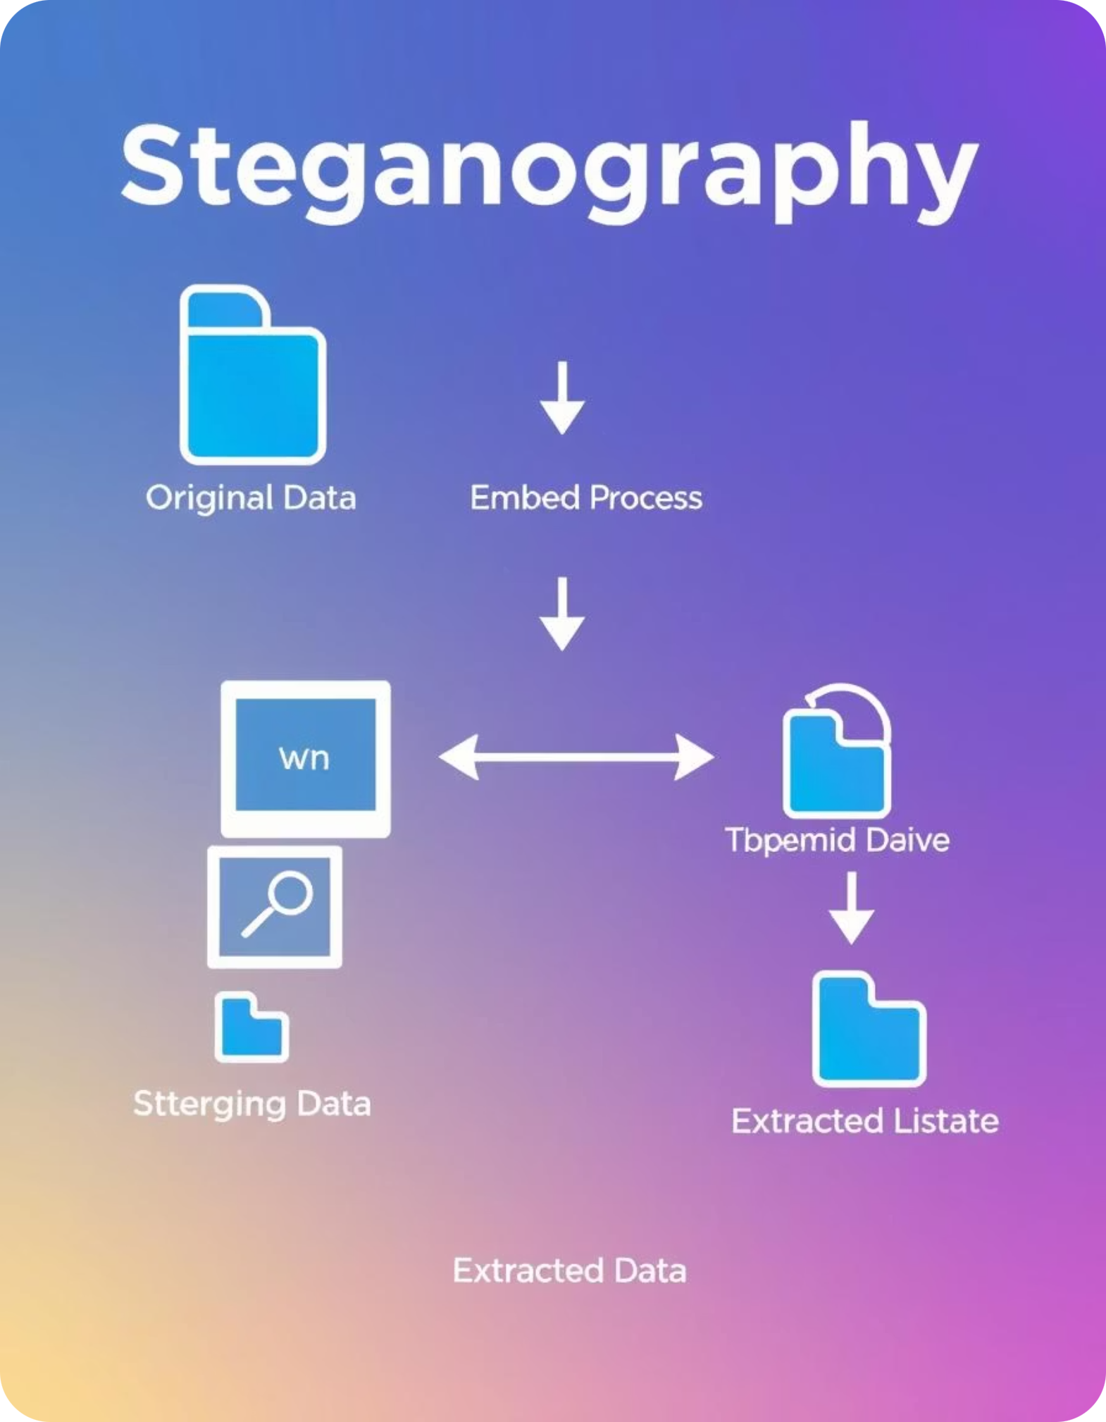
Workflow Diagram
This diagram illustrates the operational flow for embedding, extracting, and detecting hidden messages within images using STEG-X.

Slide 8
Results & Outputs
Message Hiding
Message Extraction
Detect Steganography
Successfully embedded "Secret Message!" into an image without visible distortion.
Retrieved the hidden text accurately from the steganographic image.
Successfully analysed an image for the presence of hidden data.
📤 Extract a hidden message:
python stageno.py extract stego_image.png
🧠 Detect possible steganography:
python stageno.py detect suspect.jpg
💬 Hide a message:
python stageno.py hide input.png output.png "The code is 42"
The CLI outputs demonstrate the seamless integration and functionality of STEG-X, confirming its ability to both hide, retrieve, and detect data effectively.

Slide 9

Conclusion & Learnings
Developed a functional Python CLI tool for image steganography.
Gained hands-on experience with LSB techniques and image manipulation.
Acquired practical skills in Python programming and library usage.
Enhanced understanding of cybersecurity principles and data concealment.

Slide 10
Future Scope
Enhanced Security
Multimedia Expansion
GUI Development
Implement AES encryption for hidden messages.
Extend steganography capabilities to audio and video files.
Create a user-friendly graphical interface for wider accessibility.
These future enhancements aim to transform STEG-X into a comprehensive and more secure steganography solution.

Slide 11
Thank You

